Slide 1
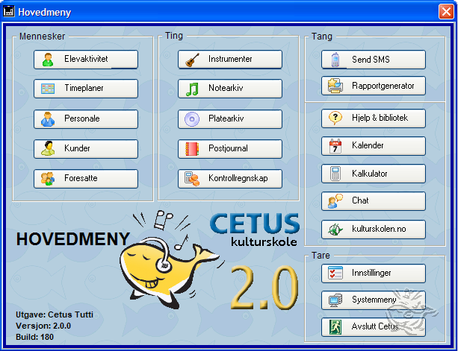
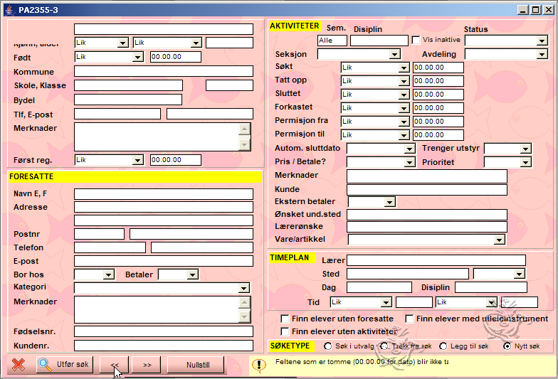
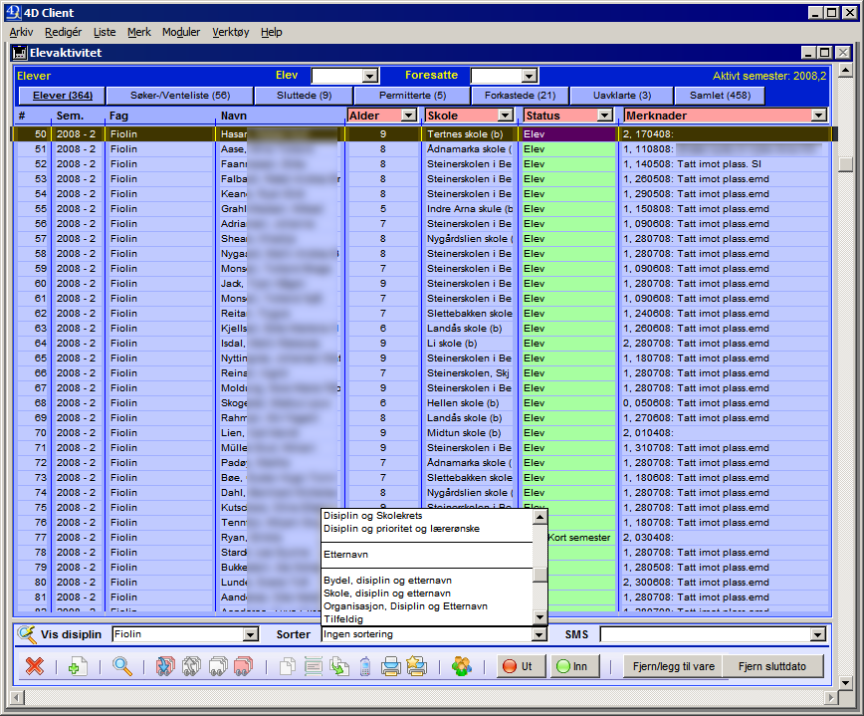
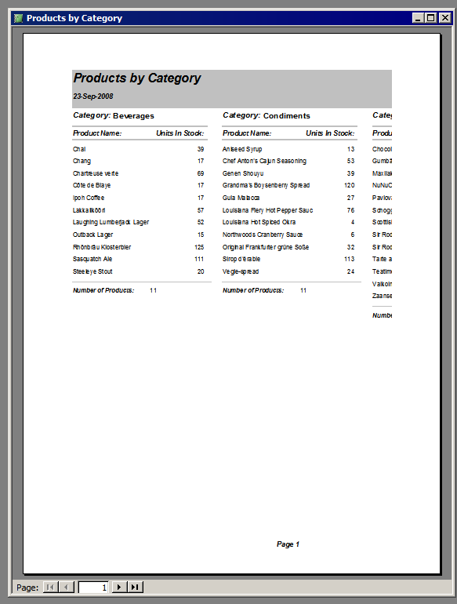
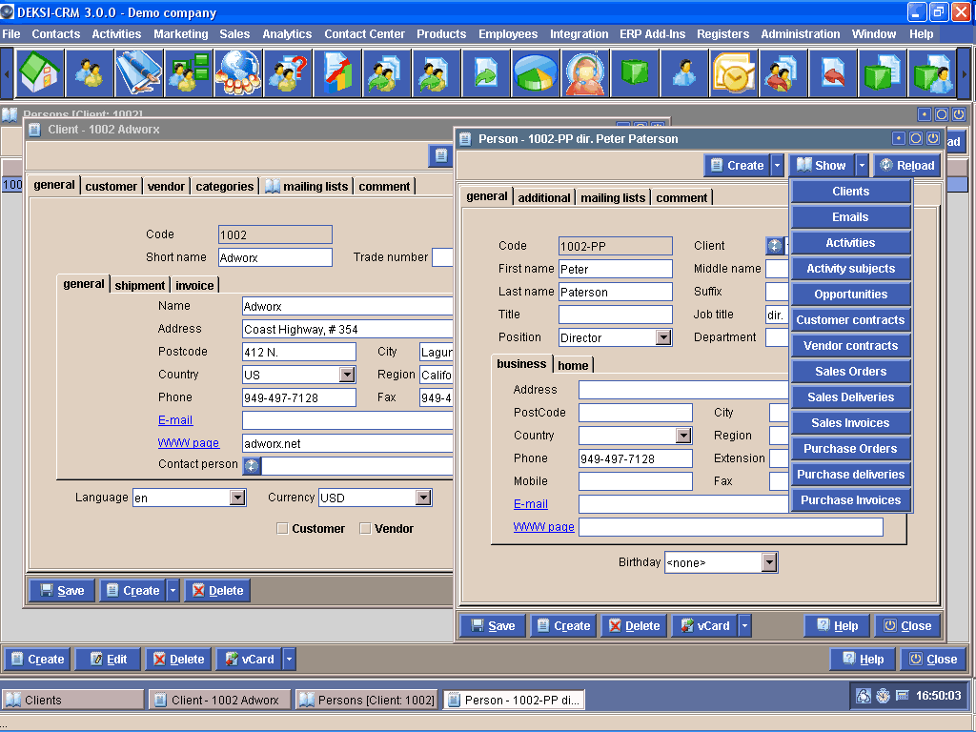
A Common Class of Business-Oriented Database Applications
Switchboard
Search form
Reports
Table view
Form view
Notes:
<number>

Slide 2
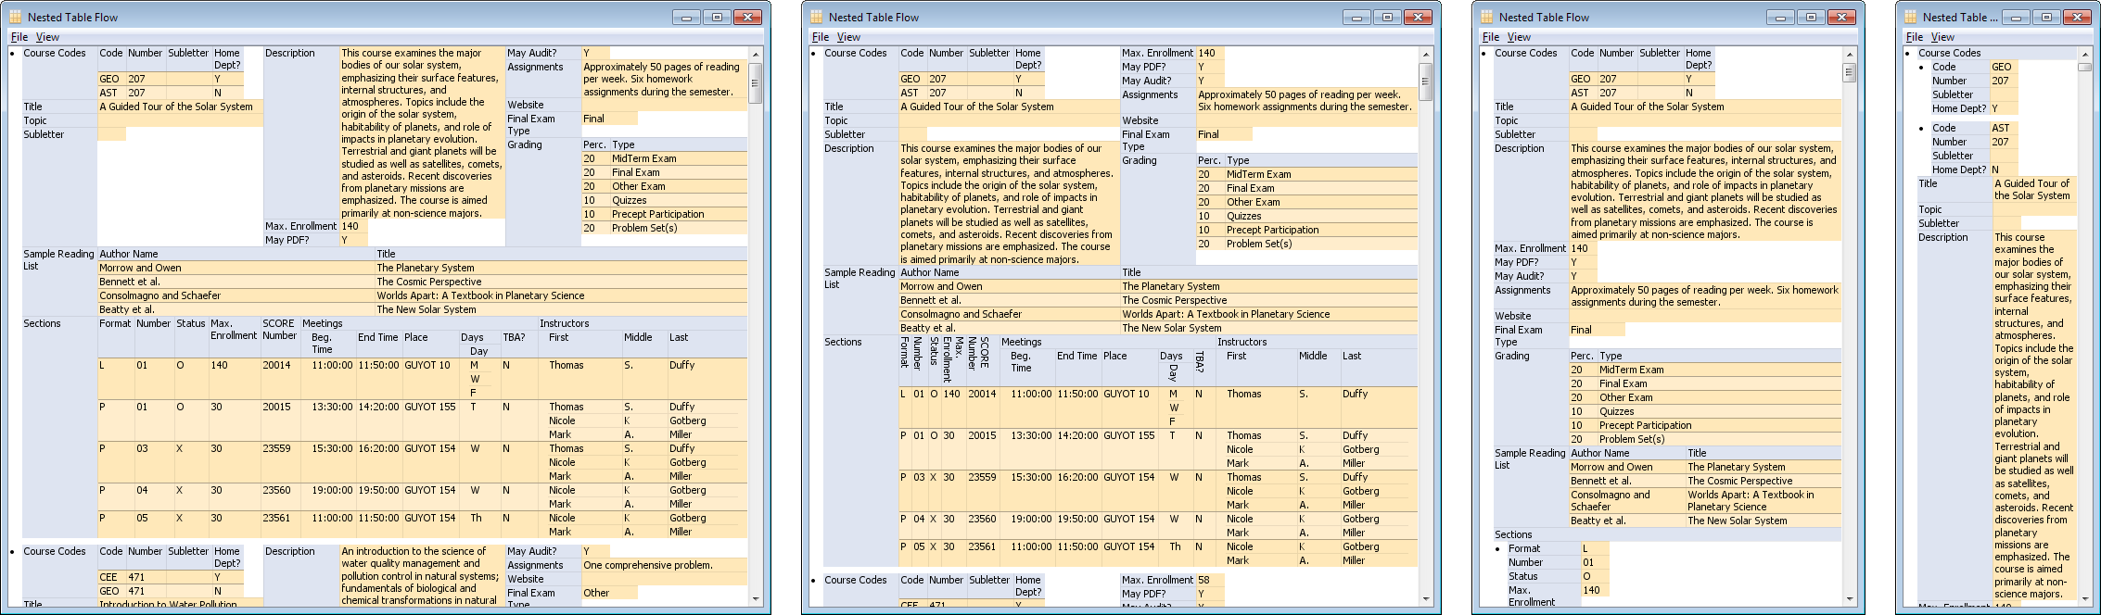
A custom Swing component that provides a
spreadsheet-like
user interface to
arbitrary table-, form-, and report views

Slide 3
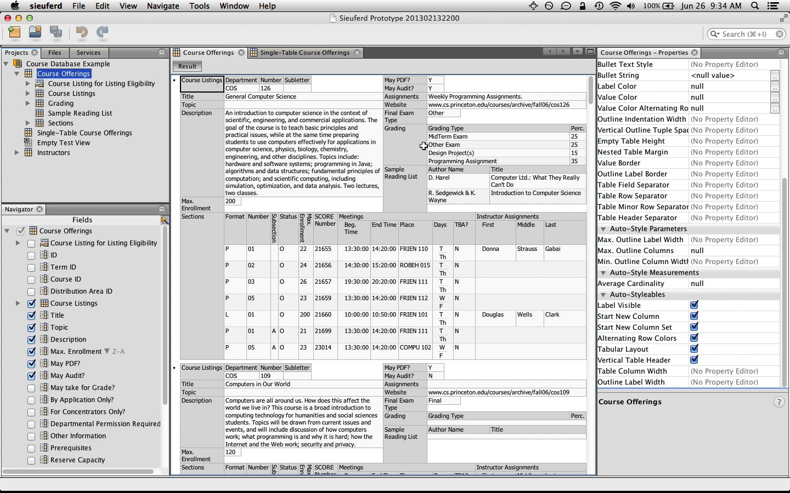
NetBeans Platform!
A Schema-Independent End-User
Front End for Relational Databases (Sieuferd)

